Slide 1
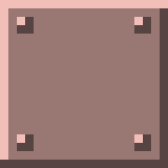
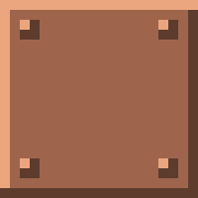
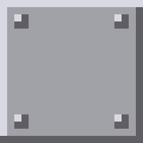
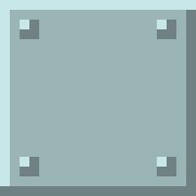
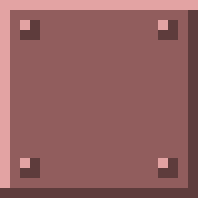
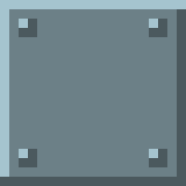

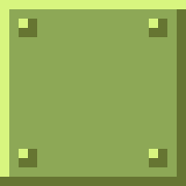
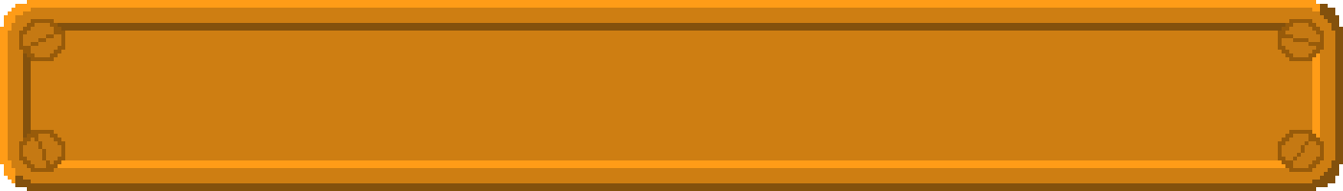
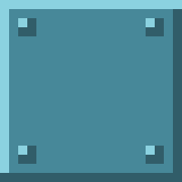
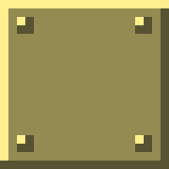
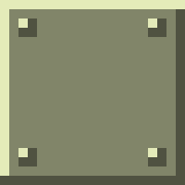
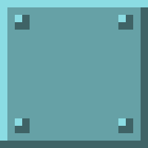
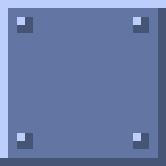
Nilesh Magan - Jilada Eccleston
Notes:
Welcome, I’m ___ and this is my partner ___. We are both here to present our game, {Game name} to you today. {Game name} stems from the popular 1980s Atari 2600 game, Warlords, providing a modern take on the game with a twist in the theme. Like Warlords, the aim of the game is to use your player’s paddle to protect your player character and walls from the moving ball.

Slide 2
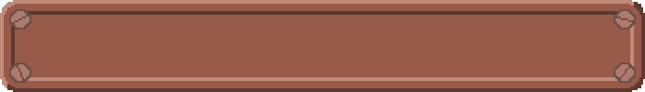
SYSTEM REQUIREMENTS
Welcome Screen and Game-Mode Selection
Countdown timer and Game Initialisation
Ball Spawned with Random Velocity
Window Boundary – 1024x768
Collision Detection of Objects -
Predictable Collision Events
Collision Sounds
Time Limit – Two Minutes
Button Press Commands
Pause Game – “P”
Return to Main Menu – “Esc”
End Time – “Page Down”
Evaluated Win Conditions
Notes:
To create this game, we needed to meet some basic system requirements, as listed in the current slide. The first line of contact the user has with the game is the intro scene. The game is initialised after the player selects the number of plays in the game. A countdown timer will also appear dictating the start of the game. When the countdown timer reaches zero, the ball then begins to move in a random velocity. It will rebound and play a sound when it collides with any one of the game objects. During this time, a timer is set to 2 minutes (120 seconds) and begins to count down. Meanwhile the players are able to press P, Esc and page down to pause, leave or end the time in the game, respectively. If a player wins, the players will be transitioned to the win screen displaying the winner.

Slide 3
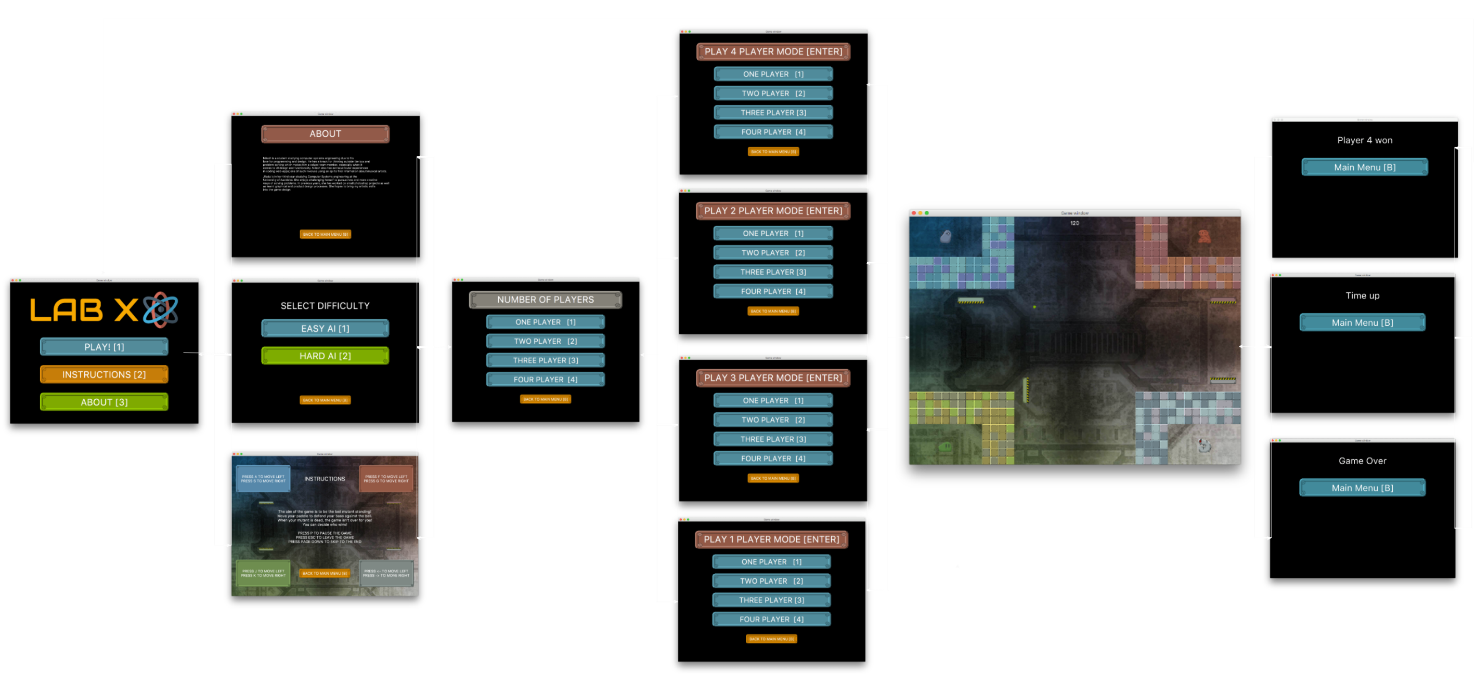
SYSTEM FLOW DIAGRAM
Notes:
The flow of the game was as structured before. The following system diagram represents the choices the user has before starting the game and also how the game returns to the start screen. The players have 3 options to begin with, the Controls Demo menu will help the players learn the keys to be pressed and the aim of the game. By clicking About, the players can learn about the developers and the copyright information of the game. The players are also presented with the choice of how many players are playing the game before the game starts.

Slide 4
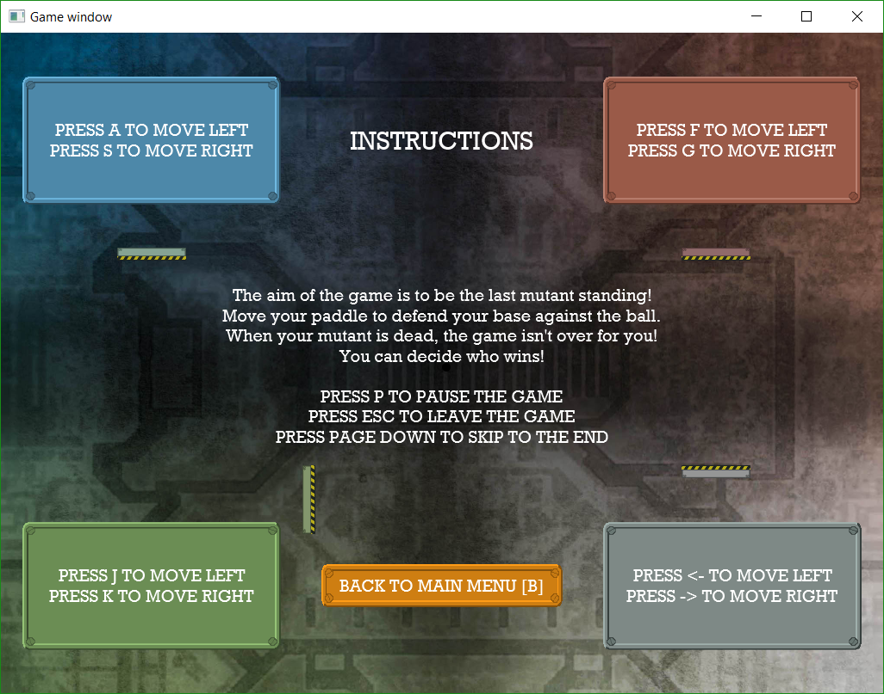
INTERACTIVE CONTROLS DEMO
Paddles in the controls menu are delivered in a way that is interactive to the players
Relevant for younger players of the game
Paddles move in the controls menu!
Notes:
Part of our game was to introduce a means of getting use to the controls each player would use. To do this our control menu no one shows the user how to play the game but also allows the user to practice moving the paddles. This is especially key to younger players who may find the interaction somewhat fun.

Slide 5
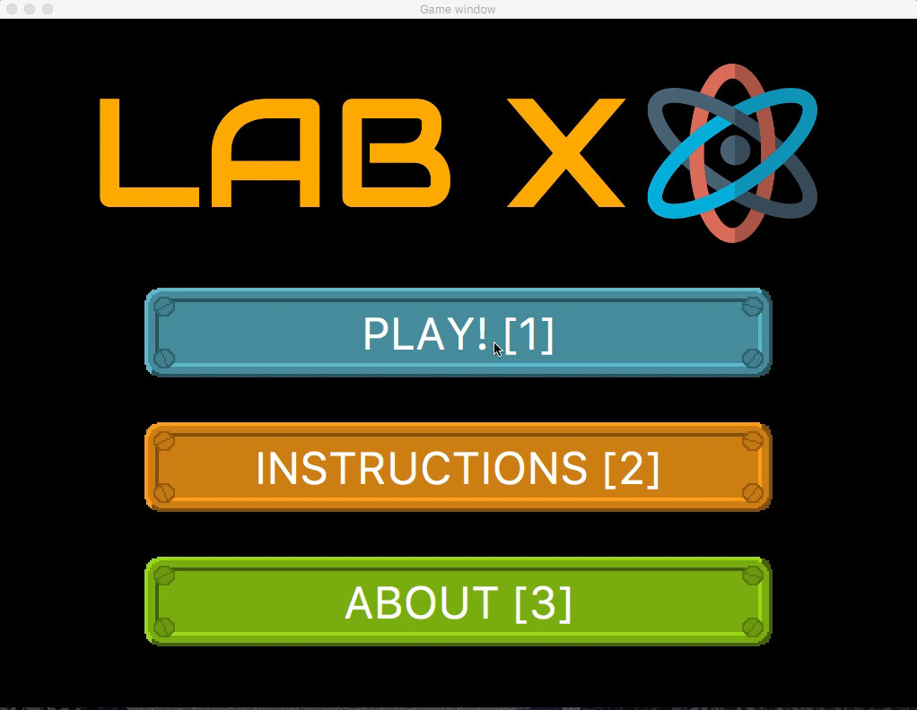
GAME PLAY OVERVIEW
Notes:
The following video demonstrates the gameplay overview, played with cut-scenes for the purposes of demonstrating the actions that occur in the game. INTRODUCE THE STORY HERE?

Slide 6
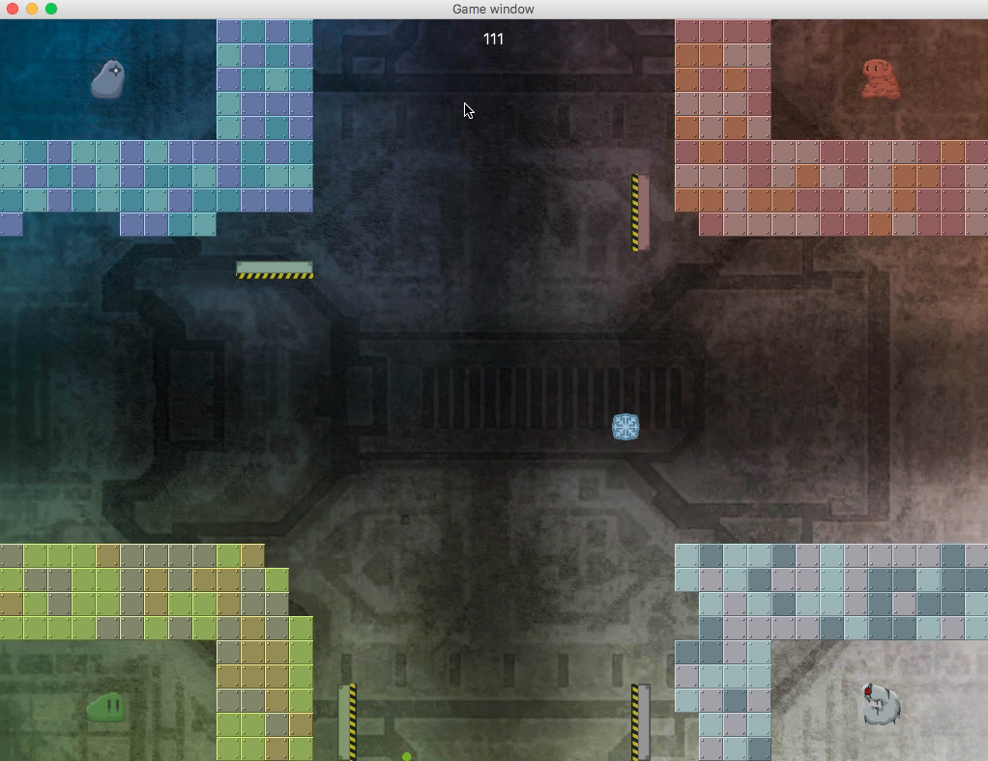
GAME PLAY OVERVIEW
Notes:
The following video demonstrates the gameplay overview, played with cut-scenes for the purposes of demonstrating the actions that occur in the game. INTRODUCE THE STORY HERE?

Slide 7
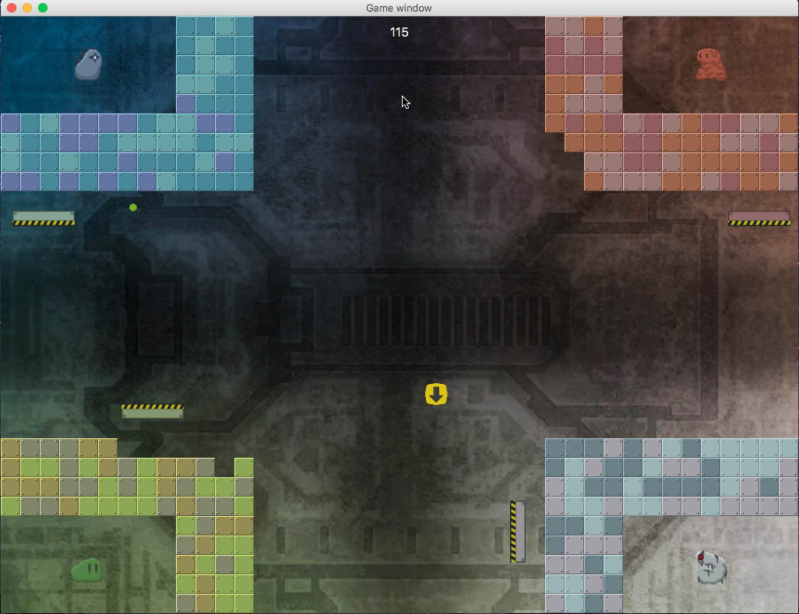
GAME PLAY OVERVIEW
Notes:
The following video demonstrates the gameplay overview, played with cut-scenes for the purposes of demonstrating the actions that occur in the game. INTRODUCE THE STORY HERE?

Slide 8
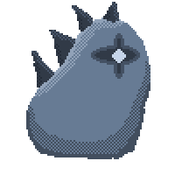

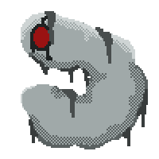
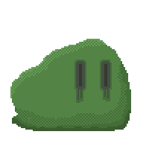
GRAPHICS
Pixelated bit themed buttons and characters
Original character and paddle designs
Laboratory themed colours and designs
Pseudo-randomised wall colour generation
Notes:
A large feature in our game is the graphics we have implemented in our game. The theme of our game is mutants trying to escape a laboratory. We pulled design inspiration from a number of different popular game on the market. We went with a darker theme, providing a level of mystery and horror. With each iteration of the game, the walls are generated in a slightly different way from the last providing a unique feel to each game.

Slide 9
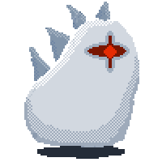
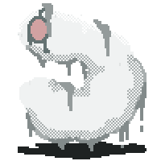


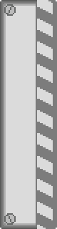



GRAPHICS
PLAYER DEATH SPRITES
BRICK SPRITES
Default Frozen Ghost
PADDLE SPRITES
Freeze Shrink Hide
POWERUP SPRITES
Notes:
Here are images taken from the game showing the different wall effects and the different paddle sprites

Slide 10
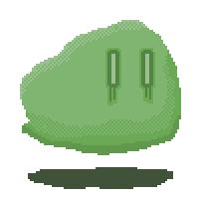
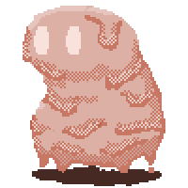
GHOST PLAYER
Ghost paddle sprites
Ghost player sprites
Allowed to interact with the ball but not able to win
Better multiplayer experience
Player is not left out once they die
Notes:
Since we have multiplayer game modes, if a player dies it would be less rewarding or satisfying to continue watching or playing the game. Allowing the player to continue playing knowing that although they can’t win they have the ability to still dictate the winner provides a more interactive experience for a better multiplayer experience. When the player dies, the remaining bricks are removed and their paddle and sprites are transformed into their ghost versions.

Slide 11
GAME MUSIC
Sets the tone of the game and the atmosphere of the players
Fast-paced music in as an opening to attract players
Theme music in gameplay:
Soft
Mysterious
Resembles the environment
Notes:
We find that music is a really important feature in most modern games, so we have chosen music specifically to provide the best atmosphere and theme for our game. As the game involves adventure the intro music was fast-paced and really to catch the attention of the players. However, once in the game play the music switches to a track is that more mysterious and soft sounding that allows the players to feel more immersed in the game and the themes of the game.

Slide 12
WHY LAB X?
Client requirements have been met and surpassed
Game music is immersive and experiential
Graphics are vibrant yet provide a dark and mysterious theme
Interactive controls demo
Ghost player interaction
Power up abilities
Notes:
So why Lab X As we have covered before, our game has met the requirements of the brief providing a base platform for the gaming experience. Our choice of music and graphics provide for a more immersive professional looking gaming experience. We provide the ability for the player to get use to the controls and interact with the paddle before beginning gameplay. We also provide a solution to players feeling left out after death in a multiplayer game.

